Slide 1
Data Types of Python
Booleans are either True or False.
Numbers can be integers (1 and 2), floats (1.1 and 1.2), fractions (1/2 and 2/3), or even complex numbers.
Strings are sequences of Unicode characters, e.g. an html document.
Lists are ordered sequences of values.
Tuples are ordered, immutable sequences of values.
Sets are unordered bags of values.
Dictionaries are unordered bags of key-value pairs.

Slide 2
Immutable Types
Strings and Tuples are immutable, which means that once we create them, we can not change them.
List , Sets and dictionaries are mutable, which means we can add , remove elements from them .

Slide 3
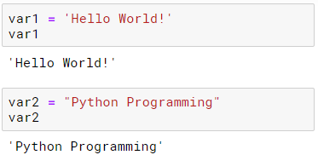
String
Strings are amongst the most popular types in Python.
We can create them simply by enclosing characters in quotes.
Python treats single quotes the same as double quotes.
Creating strings is as simple as assigning a value to a variable

Slide 4
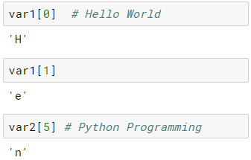
String: Accessing Elements
Python does not support a character type; these are treated as strings of length one, thus also considered a substring.
To access each character, use the square brackets along with the index. We can access a specific element using an integer index which counts from the front of the sequence (starting at ZERO!)‏

Slide 5
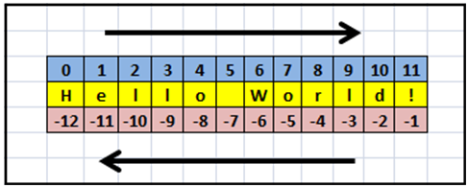
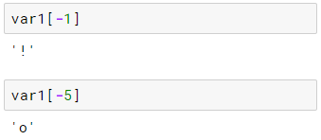
Counting Backwards
We can count from the end of the string using negative numbers also.

Slide 6
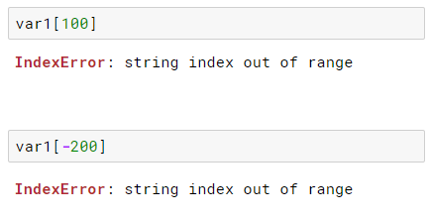
Index Out of Range!
If we try to access an element that does not exist, Python will throw an error!

Slide 7
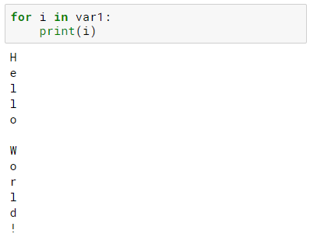
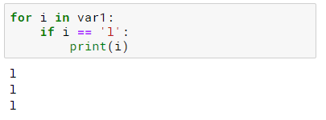
Easy Traversals – The FOR Loop
Python makes string traversals easy with a FOR loop.

Slide 8
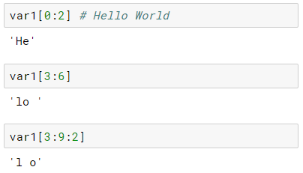
Grabbing Slices from a String
The slice operator will clip out part of a sequence.
It work a lot like the range function, but with a colon that separates the “start” and “end” points.
Syntax : VAR [ START : END : STEP]

Slide 9
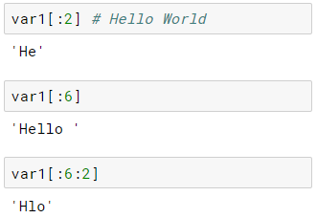
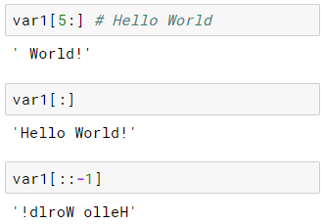
Slices – Default Values for Blanks
If one leave the “start” part blank, it assumes you want zero.
If one leave the “end” blank, it assumes you want until the end of the string

Slide 10
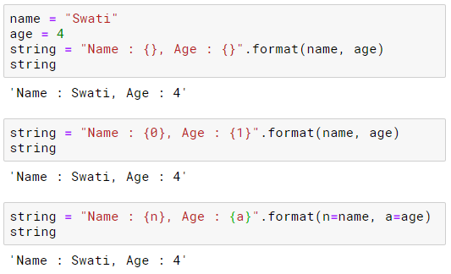
String - Methods
format() - The string format() method formats the given string into a nicer output in Python.

Slide 11
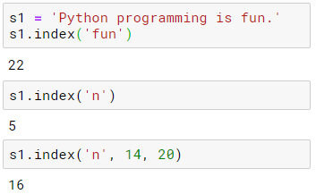
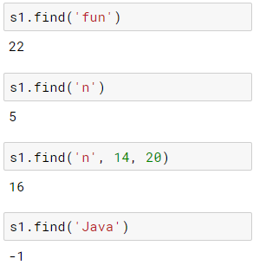

String - Methods
Index() - Returns Index of Substring
find() - Returns the index of first occurrence of substring
count() - returns occurrences of substring in string
Notes:
The index() method is similar to find() method for strings. The only difference is that find() method returns -1 if the substring is not found, whereas index() throws an exception.

Slide 12

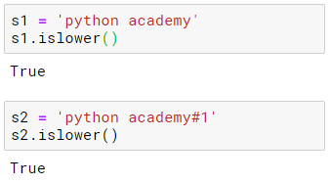



String - Methods
islower() - Checks if all Alphabets in a String are Lowercase
lower() - returns lowercased string
upper() - returns uppercased string
isupper() - Checks if all Alphabets in a String are Uppercase
swapcase() - swap uppercase characters to lowercase; vice versa

Slide 13






String - Methods
capitalize() - Converts first character to Capital Letter
isalnum() - Checks Alphanumeric Character
isalpha() - Checks if All Characters are Alphabets
lstrip() - Removes Leading Characters
rstrip() - Removes Trailing Characters
isnumeric() - Checks Numeric Characters

Slide 14
List
A list is a data structure that holds an ordered collection of items i.e. you can store a sequence of items in a list.
The list of items should be enclosed in square brackets so that Python understands that you are specifying a list.
Once you have created a list, you can add, remove or search for items in the list.
Since we can add and remove items, we say that a list is a mutable data type i.e. this type can be altered.

Slide 15
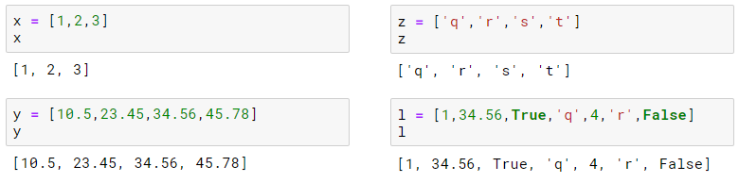

Using List
A list is represented with [ ] (square brackets) and is created by providing values separated by “,”.
List allow duplicates of values.

Slide 16
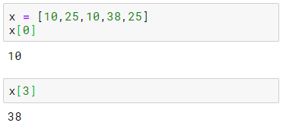
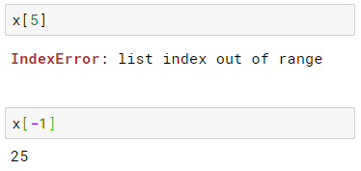
Using List
A list contains ordered set of elements , hence can be accessed by using index which starts from 0.
Index values greater than range then error is generated.
Reverse index is also possible just like strings.

Slide 17
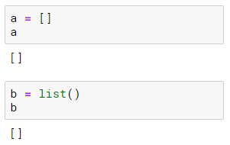
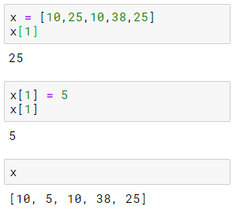
Empty List Creation
Empty list can be created in two different ways.
Elements in list can be updated since list is mutable.

Slide 18
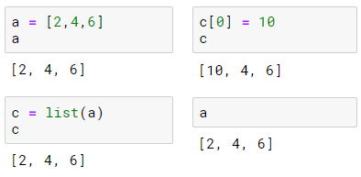
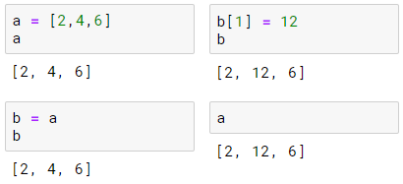
List Assignment and Equivalence
List assignment is used to assign all the elements of list to another list.
Here , memory is allocated for both objects separately. This is called Deep Copy
Whereas here , same memory is used. This is called Shallow copy.

Slide 19
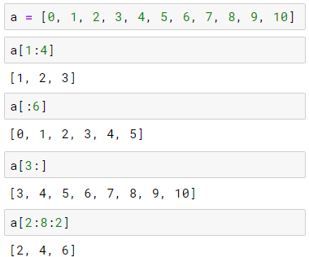
List slicing
List slicing is same as string slicing .

Slide 20
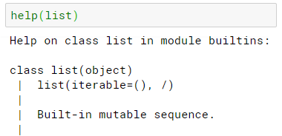
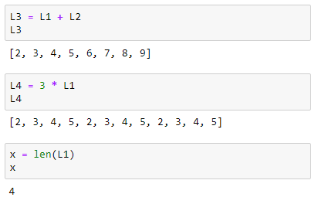
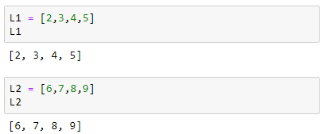
List class Methods
Since list is a class , it has many methods attached with it. We can check all methods using following help function .
Operator overloaded and len() function

Slide 21
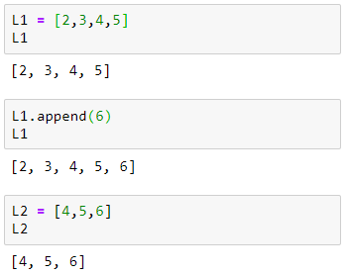
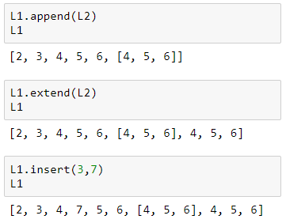
List class Methods (addition)
Add new element to the list – append , extend , insert.

Slide 22
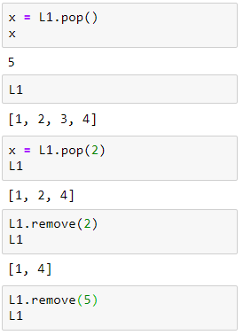
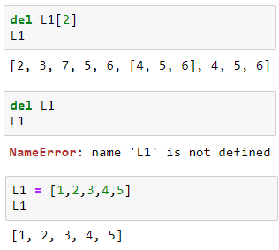
List class Methods (Deletion)
Delete element from list – del , pop , remove

Slide 23
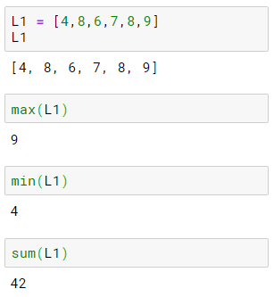
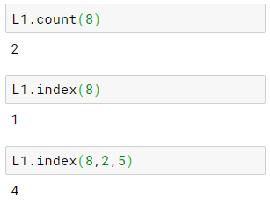
List class Methods (agg & sort)
Aggregate methods– max , min ,sum , count , index

Slide 24

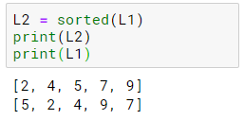
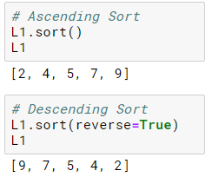

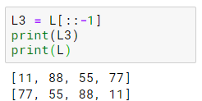

List class Methods (agg & sort)
Sorting :
Out-place sorting :
In-place sorting :
Reverse :
Out-place reverse :
In-place reverse :

Slide 25
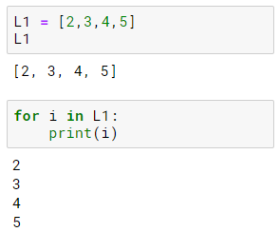
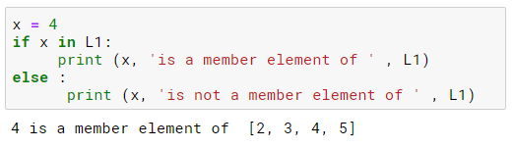
List Membership operations
Since list is a sequence , we can use simple loop for selecting each elements one by one.
We can directly check if the element is part of given list

Slide 26
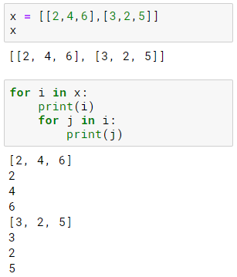

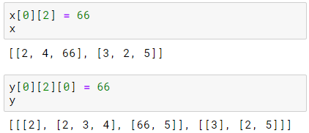
Nested list
List can have list itself as its elements.
Print individual elements for following list.
To update element ‘6’ of list x and y.

Slide 27
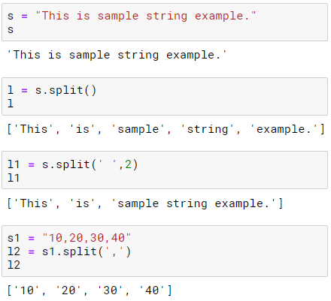
Splitting strings into list
The split() method returns a list of strings after breaking the given string by the specified separator.
str_var.split(separator, maxsplit)
separator : The string splits at this specified separator. If is not provided then any white space is a separator.
maxsplit : It is a number, which tells us to split the string into maximum of provided number of times. If it is not provided then there is no limit.

Slide 28
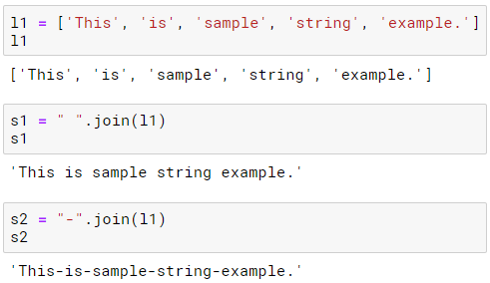
Joining list into string
The join() method returns a string in which the elements of sequence have been joined by string separator.
S.join(iterable)
S is the separator between elements in iterable.
iterable – is the objects capable of returning its members one at a time. Some examples are List, Tuple, String, Dictionary and Set.

Slide 29
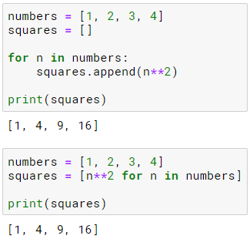
List comprehension
List comprehensions are used for creating new list from another iterables.
As list comprehension returns list, they consists of brackets containing the expression which needs to be executed for each element along with the for loop to iterate over each element.
Basic syntax:
Find squares of a number using for loop.
new_list = [expression for_loop_one_or_more condtions]

Slide 30
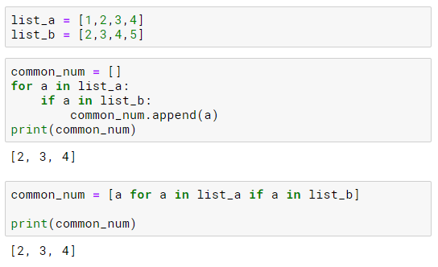
List comprehension
Example 2 : Find common numbers from two list using for loop.

Slide 31
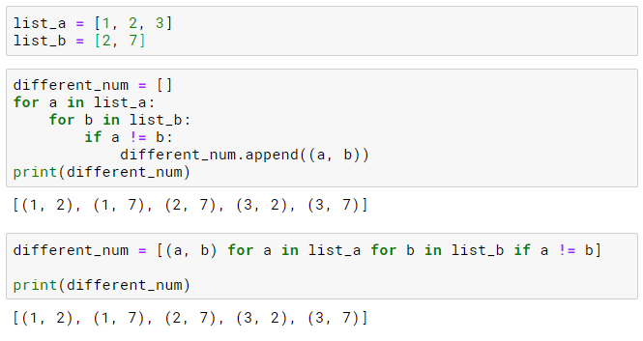
List comprehension
Example 3: Combine the different numbers from two given list.

